Slide 1
NAVCON
An assistive device to the visually impaired to support with
Navigation
Object recognition

Slide 2
Project Proposal

Slide 3
Agenda
Need for this Project
Target achievable
High Level Implementation plan
System Architecture
System IO
Explanation on the subsystems

Slide 4
Need for the Project
Its high time, the visually challenged can travel safely and perceive the surroundings

Slide 5
Design Considerations
Business Value
Key factors considered for the design include:
Optimal information of the surroundings
Light weight device and not bulky
Safety is utmost important
Simple user interface
Cost effective
Should work both Indoor and Outdoor
Current market devices only support one functionality primarily, either Navigation or Object recognition.
It is important for the blind person to understand the surrounding he is currently situated in. This would help the individual to make quality judgement.
An individual looking for a chair, system should be able to identify a chair and cannot be treating it as an obstacle.
Primary Capabilities
Navigation | Recognition
Realtime guidance on the current location to the desired destination in both indoor and outdoor environments, while avoiding obstacles | On Demand basis, when the individual needs assistance on a object finding or understanding the surrounding or figuring out the obstacle.

Slide 6
High Level implementation Plan
Hardware Equipment
Device to be carried by the ViP (Visually Impaired Person)
Earphone (to capture commands and provide feedback)
Camera (Red Green Blue and Depth Camera)
Inertial Measurement Unit
The device leverages the ground height continuity among adjacent image frames to
segment the ground accurately and rapidly, and then search the moving direction according to the
ground.
Smartphone
Object recognition system (CNN based system)
To help with perception and navigation
Human - machine Conversations
Audio Module
Obstacle alert – beeping sound
Speech recognition – to understand user commands
Speech synthesis – expressing semantic information of surroundings

Slide 7
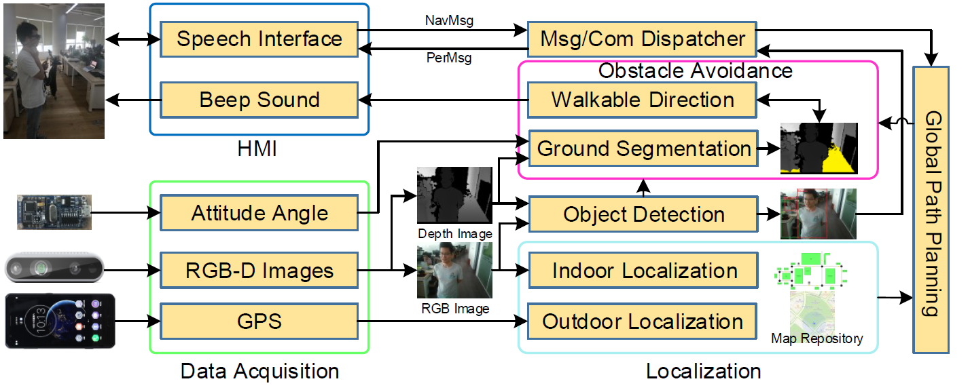
System Architecture

Slide 8
System Input - Output
Inputs | Outputs
Speech Interface Module - acquires and recognizes verbal instructions from the user | Speech Interface Module – convert the output of navigation system in to a beeping sound and output of recognition systems in to speech
RGB-D Camera - captures the depth and color images in both indoor and outdoor scenarios | Recognition system – to output the object type, distance and orientation.
IMU sensor - acquire the precise angle of the camera
Smartphone - Determine the current position in outdoor environment, perform navigation, object recognition algorithm and play the audio feed back.
Map repository
Dataset of the objects to be used in the recognition system

Slide 9
Navigation system
Localization – estimate the current user location
Path Planner – estimate the path from current location to destination/ keep going
Obstacle Avoidance – determine the walkable path based on Path planner
Indoor
VSLAM (maps)
A* algorithm (Shortest distance)
Outdoor
- GPS Module (Google Maps)
Obstacles
Static
Non-static
Adaptive Ground Segmentation
Optimal Walkable Direction Search

Slide 10
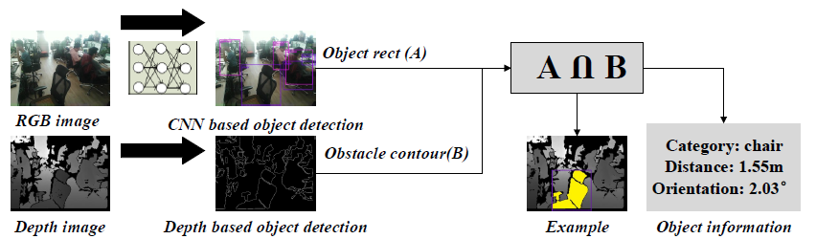
Level 1 – Perception
Level 2 – Comprehension
Level 3 – Projection
Recognition system
CNN Based Object Detection – detect the object category
Depth Based Object Detection – detect the object location and orientation

Slide 11
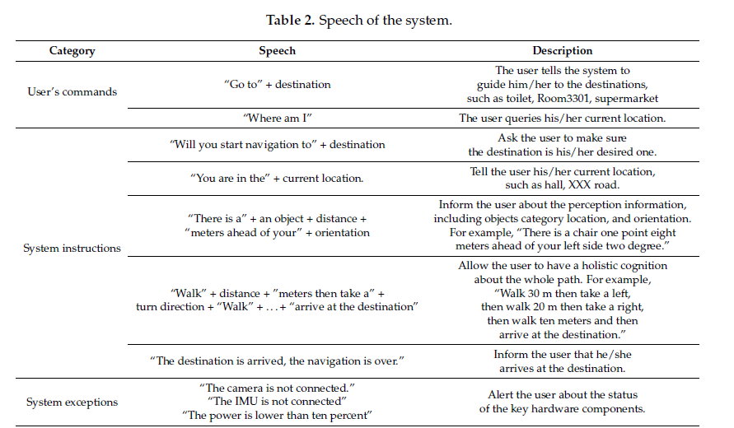
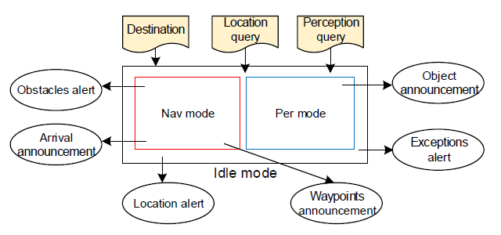
Human Machine Interaction
Speech and Audio
Text to speech
Speech Recognizer

Slide 12
Model Evaluation
Computational cost
System performance in real world scenario

Slide 13
Coverage of Sem2 Modules

